Slide 1
Sensor Subsystem Design
Aniruddh Pandey

Slide 2
Sensor Subsystem Overview
Sensor Type | Model | Purpose | Location
Pressure | BMP280 | To calculate altitude using the air pressure | Carrier
GPS | NEO-M8N | To track the position of the carrier | Carrier
IMU | MPU9250 | To detect the carrier’s orientation and the direction in which it’s heading | Carrier
Temperature | BMP280 | To read the air temperature | Payload
Pressure | BMP280 | To calculate altitude using the air pressure | Payload
Air Speed | MPXV7002DP | To detect the air speed | Payload
Presenter: Name goes here

Slide 3
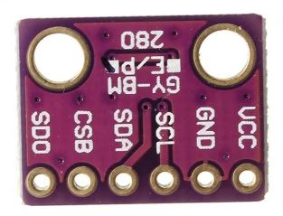
Payload Air Pressure Sensor Trade & Selection
Model | Interface | Current Draw @1Hz | Supply Voltage | Resolution (hPa) | Accuracy (hPa) | Temperature range (°C) | Size (mm) | Cost ($)
MS5611 | I2C & SPI | 1.5 mA | 5 V | 0.012 | ±1.5 | -40 to 85 | 18x14 | 12.23
BMP280 | I2C & SPI | 1.12 mA | 3.3 V | 0.01 | ±1 | -40 to 85 | 15x12 | 0.88
MPL311A52 | I2C | 2 mA | 3.3 V | 0.015 | ±4 | -40 to 85 | 18x19 | 14.95
Selected : BMP280
Rationale : highest accuracy and resolution, less size and low cost
Presenter: Name goes here

Slide 4
Payload Air Temperature Sensor Trade & Selection
Model | Interface | Current Draw @1Hz | Supply Voltage | Resolution (°C) | Temperature range (°C) | Size (mm) | Cost ($)
MS5611 | I2C & SPI | 1.5 mA | 5 V | 0.01 | -40 to 85 | 18x14 | 12.23
BMP280 | I2C & SPI | 1.12 mA | 3.3 V | 0.01 | -40 to 85 | 15x12 | 0.88
Selected : BMP280
Rationale : Already being used as pressure sensor
Has good resolution and sufficient range
Presenter: Name goes here

Slide 5
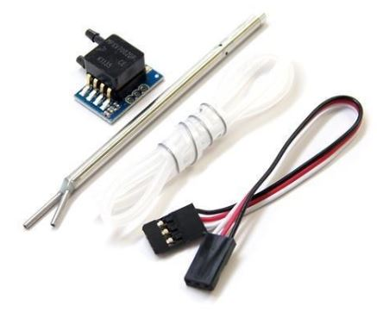
Payload Air Speed Trade & Selection
Model | Interface | Current Draw | Measurement Range | Resolution | Cost ($)
MPXV7002DP | Analog | 10 mA | 1 psi, 100 m/s | 0.84 Pa | 26.96
MS4525DO | I2C & SPI | 3 mA | 1 psi, 100 m/s | 0.84 Pa | 52.91
Selected : MPXV7002DP
Rationale : Easy to program
Is reliable and almost half the cost of the
other option
Presenter: Name goes here

Slide 6
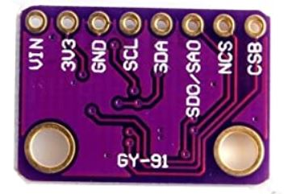
Container Air Pressure Sensor Trade & Selection
Model | Interface | Current Draw @1Hz | Supply Voltage | Resolution (hPa) | Accuracy (hPa) | Temperature range (°C) | Size (mm) | Cost ($)
MS5611 | I2C & SPI | 1.5 mA | 5 V | 0.012 | ±1.5 | -40 to 85 | 18x14 | 12.23
BMP280 | I2C & SPI | 1.12 mA +3.93 of mpu9250 | 3.3 V | 0.01 | ±1 | -40 to 85 | 15x12 | 10.88
MPL311A52 | I2C | 2 mA | 3.3 V | 0.015 | ±4 | -40 to 85 | 18x19 | 14.95
Selected : BMP280
Rationale : highest accuracy and resolution, and the sensor is available with the IMU module on the same PCB
Presenter: Name goes here

Slide 7
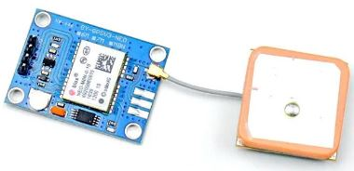
Container GPS Sensor Trade & Selection
Model | Interface | Supply Voltage | Current Draw | Resolution (m) | Cold Start time (s) | Size (mm) | Weight (g) | Cost ($)
Neo-6M | SPI / I2C/ UART / USB | 3.3 V | 37 mA | 2.5 | 27 | 22x30x4 | 12 | 9.5
Neo-M8N | SPI / I2C/ UART / USB | 3.3 V | 23 mA | 2-2.5 | 30 | 26x36x4 | 17 | 18.88
Adafruit ultimate gps | UART & I2C | 3.3/5 V | 20 mA | 1.8 | 34 | 15x15x4 | 8.5 | 40
Selected : NEO-M8N
Rationale : Supports 72 receiving channels and is reliable
Presenter: Name goes here

Slide 8
Container Orientation Sensor Trade & Selection
Model | Interface | Accelerometer range(g) | Gyroscopic range(°/s) | Magnetometer range(μT) | Current Draw | Cost ($)
MPU9250 | I2C & SPI | ±2g, ±4g, ±8g, ±16 g | ±250°/s, ±500°/s, ±1000°/s, ±2000°/s | ±4800μT | 3.93 mA (+1.12 of BMP280) | 10.88
BMX055 | I2C & SPI | ±2g, ±4g, ±8g, ±16 g | ±125°/s, ±250°/s, ±500°/s, ±1000°/s, ±2000°/s | ±1300μT (x,y), ±2500μT (z) | 5.63 mA
Selected : MPU9250
Rationale : Easily available and programable
High reliability and the module also has
BMP280 pressure sensor
Presenter: Name goes here

Slide 9
Communication and Data Handling (CDH) Subsystem Design
Aniruddh Pandey

Slide 10
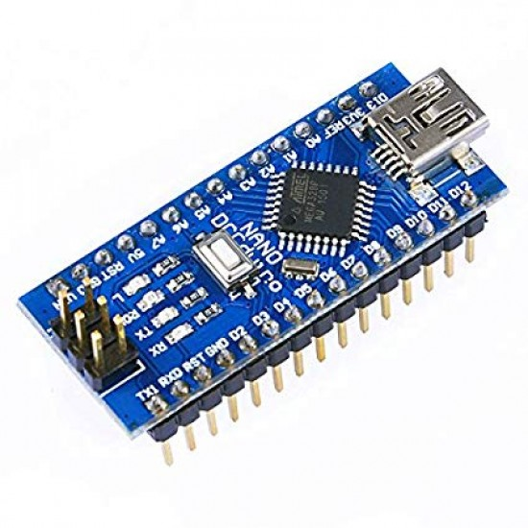
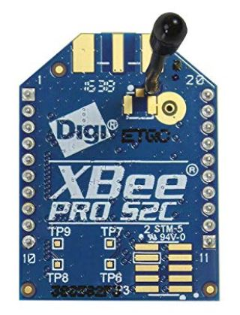
Container Command Data Handler (CDH) Overview
NEO-M8N
It is going to act as the RTC module
Arduino Nano
Microcontroller
Data collector and processor
XBee Pro S2C
Transmit and receive data
Presenter: Name goes here

Slide 11
Container Processor & Memory Trade & Selection
Microcontroller | Processor Speed (MHz) | Boot time | Interfaces | RAM (kB) | Operating Voltage | Weight (g) | Cost ($)
Arduino Nano | 16 | 8-10 | 1 SPI,1 I2C, 1 UART | 2 | 5 V | 7 | 4.75
Teensy 3.6 | 180 | 15 | 3 SPI, 3 I2C, 7UART | 256 | 3.3 V | 4.9 | 29.25
Teensy 4.0 | 600 | 5 | 3 SPI,4 I2C, 6 UART | 1024 | 3.3 V | 10 | 19.95
Selected : Arduino nano
Rationale : Sufficient number of pins
Low cost
Easy to program
Presenter: Name goes here

Slide 12
Container Real-Time Clock
Model | Operating Voltage (V) | Current (mA) | Accuracy (ppm) | Hardware/ Software | Cost ($)
Arduino nano | 5 | 19 | 50 | Software | Free( comes with Arduino )
NEO-M8N | 3.3 | 23 | 20 | Hardware | Free( comes with the GPS )
Selected : NEO-M8N
Rationale : It has backup battery to maintain mission
time in case of system reset due to power
interuption
High accuracy
Presenter: Name goes here

Slide 13
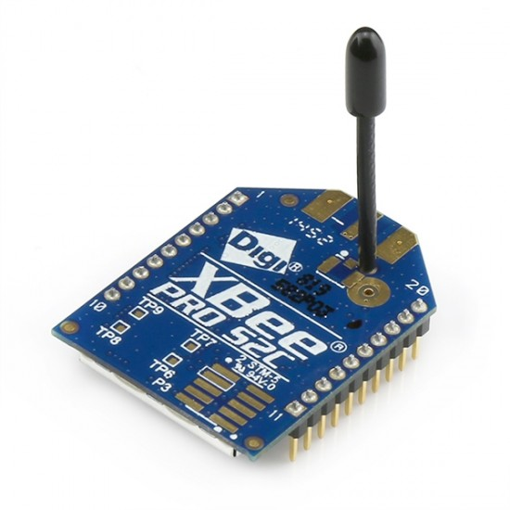
Container Radio Configuration
Model | Operating frequency (GHz) | Transmitting power(dBm) | Receiver sensitivity(dBm) | Transmit current (mA) | Range (km)
XBee-Pro S2C | 2.4 | +18 | -101 | 120 | 3.2
XBee-Pro S2C is selected for radio communication
The container will have only 1 XBee
Configuration the XBee will be done using XCTU software
This XBee will have the coordinator role
Data transmission will be done in broadcast mode
Presenter: Name goes here

Slide 14
Container Telemetry Format 1 of 2
Data Format | Example | Description
Mission time | 12:15:45 | is UTC time in format hh:mm:ss, where hh is hours, mm is minutes, and ss is seconds
Packet count | 245 | the count of transmitted packets which is to be maintained through processor reset
Packet type | C | the character ‘C’ for carrier telemetry and ‘SP’ for science payload
Altitude | 500 | the altitude in meters relative to ground level. Resolution is <0.1m
Latitude | 4124.2028 | is the latitude generated by the GPS receiver in decimal degrees with a resolution of 0.0001 degrees
Longitude | 210.4418 | is the longitude generated by the GPS receiver in decimal degrees with a resolution of 0.0001 degrees.
Pitch | 64 | is the tilt angle in the pitch axis in degrees
Roll | 72 | is the tilt angle of the roll axis in degrees
Yaw | 60 | is the tilt angle of the yaw axis in degrees
Presenter: Name goes here

Slide 15
Container Telemetry Format 2 of 2
Data packet will be transmitted at the rate of 1 Hz in burst
Carrier data packet format :
<Mission_Time>, <Packet_Count>, <Packet_Type>, <Altitude>, <Latitude>,<Longitude>,<Pitch>,<Roll>,<Yaw>
Example:
12:15:45,245,C,500,4124.2028,210.4418,64,72,60
Data packet will be stored in a CSV file named “Carrier.csv”
Science payload data relayed by carrier data packet format:
<Packet_Count>,<Packet_Type>,<Altitude>,<Temperature>,<Air_Speed>
Example:
23,SP,500,20,20
Data packet will be stored in a CSV file named “Science_payload.csv”
Presenter: Name goes here

Slide 16
Payload CDH Overview
Arduino Nano
Microcontroller
Data collector and processor
XBee Pro S2C
Transmit and receive data
Presenter: Name goes here

Slide 17
Payload Processor & Memory Trade & Selection
Microcontroller | Processor Speed (MHz) | Boot time | Interfaces | RAM (kB) | Operating Voltage | Weight (g) | Cost ($)
Arduino Nano | 16 | 8-10 | 1 SPI,1 I2C, 1 UART | 2 | 5 V | 7 | 4.75
Teensy 3.6 | 180 | 15 | 3 SPI, 3 I2C, 7UART | 256 | 3.3 V | 4.9 | 29.25
Teensy 4.0 | 600 | 5 | 3 SPI,4 I2C, 6 UART | 1024 | 3.3 V | 10 | 19.95
Selected : Arduino nano
Rationale : Sufficient number of pins
Low cost
Easy to program
Presenter: Name goes here

Slide 18
Payload Radio Configuration
Model | Operating frequency (GHz) | Transmitting power(dBm) | Receiver sensitivity(dBm) | Transmit current (mA) | Range (km)
XBee-Pro S2C | 2.4 | +18 | -101 | 120 | 3.2
XBee-Pro S2C is selected for radio communication
The payload will have only 1 XBee
Configuration the XBee will be done using XCTU software
This XBee will be configured as an end device
Data transmission will be done in unicast mode
Presenter: Name goes here

Slide 19
Payload Telemetry Format
Data Format | Example | Description
Packet count | 25 | the count of transmitted packets which is to be maintained through processor reset
Packet type | SP | the character ‘C’ for carrier telemetry and ‘SP’ for science payload
Altitude | 500 | the altitude in meters relative to ground level. Resolution is <0.1m
Temperature | 20 | is the measured temperature in degrees Celsius with a resolution of 0.1
Air Speed | 20 | the air speed relative to the payload in meters/second
Data Format :
<Packet_Count>,<Packet_Type>,<Altitude>,<Temperature>,<Air_Speed>
Example:
23,SP,500,20,20
Data packet will be transmitted from payload to container and relayed to GCS at 1Hz in burst
Data packet will be stored in a CSV file named “Science_payload.csv”
Presenter: Name goes here

Slide 20
Electrical Power Subsystem (EPS) Design
Aniruddh Pandey

Slide 21
EPS Overview (1 of 4)
Component | Purpose
3.6V ½AA Lithium Battery | Power source for the electronic system in payload as well as the container
NCR18650B Li-Ion Battery | Power source for the brushless drone motor
Switch | To connect and disconnect the battery from the circuit
Microcontroller | To provide 3.3V and 5V power bus to the sensors
3.3V regulator | To provide 3.3V power bus to the XBee radio module
Sensors | To provide environment measurements to the Arduino
XBee | To relay carrier and payload data to ground station
Presenter: Name goes here

Slide 22
EPS Overview (2 of 4)
Component | Purpose
Servo motor | Used in releasing mechanisms and controlling the powered flight
Brushless motor | To maintain levelled flight
Buzzer | To help locate the carrier after landing
Presenter: Name goes here

Slide 23
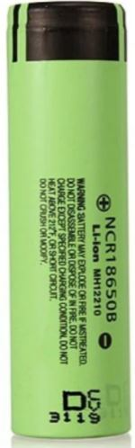
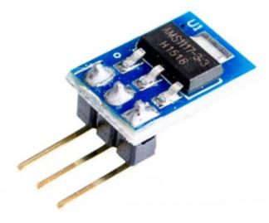
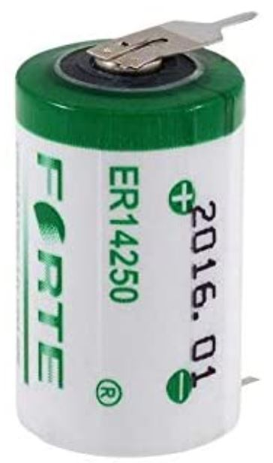
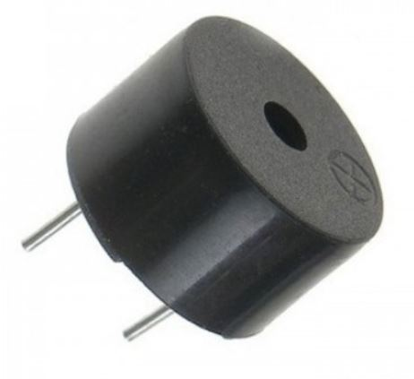
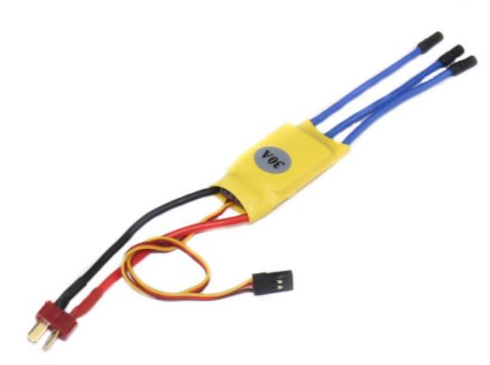
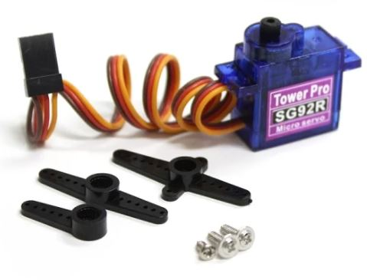
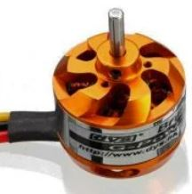
EPS Overview (3 of 4)
Container Overview
Two 3.7V batteries in series
XBee
3.3V regulator
Two 3.6V batteries in series
Arduino nano
ESC
Sensors and buzzer
Servo motors
Brushless motor
Presenter: Name goes here

Slide 24
EPS Overview (4 of 4)
Payload Overview
XBee
3.3V regulator
Two 3.6V batteries in series
Arduino nano
Sensors
Servo motors
Presenter: Name goes here

Slide 25
Container Electrical Block Diagram 1 of 2
Battery(7.2V)
3.3V regulator
3.3V
XBee
Battery(7.4V)
7.4V
ESC
Switch
(ON/OFF)
Arduino nano
3.3V
GPS
7.2V
7.4V
7.2V
Motor
5V
IMU
(MPU9250+
BMP280)
Servo 1
Servo 2
The power will be controlled via switch which will be placed in an easily accessible area.
The buzzer will be activated once the carrier lands
Servo 3
Buzzer
Presenter: Name goes here

Slide 26
Container Electrical Block Diagram 2 of 2
XBee
GPS
Interface Diagram
UART
UART
Servo 3
Arduino Nano
I2C
IMU
(MPU9250+
BMP280)
PWM 4
Servo 2
Digital
Buzzer
PWM 3
PWM 2
PWM 1
Servo 1
ESC
Presenter: Name goes here

Slide 27
Container Power Trade & Selection 1/2
Model | Type | Nominal Voltage (V) | Capacity (mAh) | Power Capacity (Wh) | Weight (g) | Cost ($)
Forte ER14250 | Lithium | 3.6 | 1200 | 4.32 | 10 | 7.29
Orange ISR 18650 | Li – ion | 3.7 | 2000 | 7.4 | 44 | 3.26
BR-2/3AGCT4A | Lithium | 6 | 2400 | 14.4 | 50 | 9.89
Selected : Forte ER14250
Rationale : Is lightweight and has sufficient power capacity
Two batteries will be attached in series to provide 7.2V and a total power capacity
of 8.64Wh. They will be mounted on a custom made battery holder.
Presenter: Name goes here

Slide 28
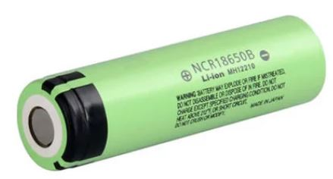
Container Power Trade & Selection 2/2
Model | Type | Nominal Voltage (V) | Capacity (mAh) | Power Capacity (Wh) | Max. Continuous Discharge Current | Weight (g) | Cost ($)
PANASONIC NCR18650B | Li - ion | 3.7 | 3400 | 12.58 | 30A | 46 | 8.53
SONY VTC6 18650 | Li - ion | 3.7 | 3000 | 11.1 | 20A | 47 | 10.9
BR-2/3AGCT4A | Lithium | 6 | 2400 | 14.4 | 4A | 50 | 9.89
Selected : PANASONIC NCR18650B
Rationale : Greater power capacity and high discharge current
Two batteries will be attached in series to provide 7.4V and a total power capacity
of 25.16Wh to the motor. They will be placed in a battery holder.
Presenter: Name goes here

Slide 29
Container Power Budget 1 of 2
Component | Current (mA) | Voltage (V) | Duty Cycle (%) | Power Consumption (Wh) | Source
Arduino nano | 19 | 5 | 100 | 0.19 | Datasheet
MPU9250 | 3.93 | 3.3 | 100 | 0.02593 | Datasheet
BMP280 | 1.12 | 3.3 | 100 | 0.00739 | Datasheet
GPS | 23 | 3.3 | 100 | 0.151 | Datasheet
XBee | 120 | 3.3 | 100 | 0.792 | Datasheet
Servo (tail) | 300 | 7.2 | 0.025 | 0.108 | Datasheet
Servo (x2) (deploying mechanism) | 300 | 7.2 | 0.00833 | 0.036 (x2=0.072) | Datasheet
Buzzer | 20 | 5 | 12.5 | 0.0125 | Datasheet
Presenter: Name goes here

Slide 30
Container Power Budget 2 of 2
Component | Current (mA) | Voltage (V) | Duty Cycle (%) | Power Consumption (Wh) | Source
Voltage regulator | 5 | 7.2 | 100 | 0.072 | Datasheet
Motor | 30A | 7.4 | 0.025 | 11.1 | Datasheet
Total power consumption by circuit : 1.43Wh
Total power consumption by motor : 11.1Wh
Available total power capacity : 8.64Wh
Available total power capacity : 25.16Wh
Margin of Power consumption : 7.21Wh
83.44%
Margin of Power consumption : 14.06Wh
55.88%
Conclusion : Both combination of batteries have sufficient power to operate the carrier for 2hrs
Presenter: Name goes here

Slide 31
Payload Electrical Block Diagram 1 of 2
3.3V regulator
XBee
3.3V
7.2V
Battery(7.2V)
Switch
(ON/OFF)
Arduino nano
BMP280
3.3V
7.2V
7.2V
7.2V
5V
MPXV7002DP
Servo 2
Servo 1
Two batteries are attached in series to provide 7.2V
The power will be controlled via switch which will be placed in an easily accessible area.
Presenter: Name goes here

Slide 32
Payload Electrical Block Diagram 2 of 2
Interface Diagram
XBee
UART
BMP280
I2C
Arduino Nano
Servo 2
PWM 2
MPXV7002DP
Analog
PWM 1
Servo 1
Presenter: Name goes here

Slide 33
Payload Power Trade & Selection
Model | Type | Nominal Voltage (V) | Capacity (mAh) | Power Capacity (Wh) | Weight (g) | Cost ($)
Forte ER14250 | Lithium | 3.6 | 1200 | 4.32 | 10 | 7.29
Orange ISR 18650 | Li – ion | 3.7 | 2000 | 7.4 | 44 | 3.26
BR-2/3AGCT4A | Lithium | 6 | 2400 | 14.4 | 50 | 9.89
Selected : Forte ER14250
Rationale : Is lightweight and has sufficient power capacity
Two batteries will be attached in series to provide 7.2V and a total power capacity
of 8.64Wh. They will be mounted on a custom made battery holder.
Presenter: Name goes here

Slide 34
Payload Power Budget 1 of 2
Component | Current (mA) | Voltage (V) | Duty Cycle (%) | Power Consumption (Wh) | Source
Arduino nano | 19 | 5 | 100 | 0.19 | Datasheet
BMP280 | 1.12 | 3.3 | 100 | 0.00739 | Datasheet
XBee | 120 | 3.3 | 100 | 0.792 | Datasheet
MPXV7002DP | 10 | 5 | 100 | 0.108 | Datasheet
Servo (x2) (deploying mechanism) | 300 | 7.2 | 0.00833 | 0.036 (x2=0.072) | Datasheet
Voltage regulator | 5 | 7.2 | 100 | 0.072 | Datasheet
Presenter: Name goes here

Slide 35
Payload Power Budget 2 of 2
Total power consumption by circuit : 1.241Wh
Margin of Power consumption : 7.399Wh
85.63%
Available total power capacity : 8.64Wh
Two batteries of 4.32Wh power capacity will be connected in series to give a total
of 8.64Wh power capacity.
Conclusion : Battery is sufficient to power all the components throughout the flight
Presenter: Name goes here

Slide 36
Flight Software (FSW) Design
Aniruddh Pandey

Slide 37
FSW Overview 1 of 3
Programming languages : C/C++
Development Environment : Arduino IDE
Carrier FSW Tasks:
Calibrate sensors and send the reference point for altitude to payload
Decide the software state based on altitude
Sample and process all data from sensors
Maintain telemetry with GCS
Command the release of payload
Act as a relay between payload and GCS
Keep updating EEPROM
Activate audio beacon on landing
Payload FSW Tasks:
Receive reference point from carrier for the altitude
Sample and process all data from sensors
Start telemetry when commanded by the carrier
Keep updating EEPROM
Presenter: Name goes here

Slide 38
FSW Overview 2 of 3
Carrier FSW Architecture
Initialize and Calibrate Sensors
Detect apogee and deploy wings
Start telemetry
Start powered flight
Power ON
Stop all functions
Detect Landing
Relay the payload data to GCS
Release the payload
Activate audio beacon
Presenter: Name goes here

Slide 39
FSW Overview 3 of 3
Payload FSW Architecture
Receive calibration data from carrier
Receive command to start telemetry
Start telemetry
Detect 500m altitude
Power ON
Stop all functions
Detect Landing
Deploy parachute
Release the heat shield
Presenter: Name goes here

Slide 40
Container FSW State Diagram 1 of 4
If
State=0
Power ON
Initialize and set variables
Read EEPROM for software state
Set software state value
Move on to respective stage
No
Yes
If
Apogee detected
Set software state to 2
Yes
Take sensor readings for altitude
Set software state to 1
Calibrate sensor and send data to payload
No
Update the state to EEPROM
Update the state to EEPROM
Write all data to EEPROM
Presenter: Name goes here

Slide 41
Container FSW State Diagram 2 of 4
Deploy wings
Start helical manoeuvre
Set software state to 3
Update the state to EEPROM
Start telemetry at 1Hz
No
If
Altitude <=1510
Record the position at that moment
Set software state to 4
Yes
Update all data into EEPROM
Increment packet count
Write data to EEPROM
No
If 300m achieved
Stop helical
manoeuvre
Start powered flight
Continue the powered flight for 300m
Stop powered flight
Yes
Presenter: Name goes here

Slide 42
Container FSW State Diagram 3 of 4
Release the payload
Command payload to start telemetry
Set software state to 5
Update the state to EEPROM
Receive payload telemetry
No
If
Altitude <5
Stop all functionalities
Set software state to 6
Yes
Update all data into EEPROM
Relay it to GCS
Activate audio beacon
A timer based interrupt will be set at 1Hz for the telemetry
Presenter: Name goes here

Slide 43
Container FSW State Diagram 4 of 4
FSW Recovery :
All the necessary data for smooth operation of flight software will be stored in the microcontroller’s EEPROM
Data stored in EEPROM :
Flight software state
Packet count
Sensor calibration data
Variables controlling sub-stages of flight
The position of carrier at the start of powered flight
The processor can reset due to software hang, overheating or if the power supply interrupts
Presenter: Name goes here

Slide 44
Payload FSW State Diagram 1 of 3
If
State=0
Power ON
Initialize and set variables
Read EEPROM for software state
Set software state value
Move on to respective stage
No
Yes
If
“START”
Set software state to 2
Yes
Wait for START command from carrier
Set software state to 1
Receive calibration data
No
Update the state to EEPROM
Update the state to EEPROM
Write all data to EEPROM
Presenter: Name goes here

Slide 45
Payload FSW State Diagram 2 of 3
If altitude<=500m
Start telemetry at 1Hz
Release the heat shield
Deploy the parachute
Yes
No
No
If altitude<=5m
Increment packet count
Continue telemetry
Update the state to EEPROM
Yes
Stop all functionalities
Update all data to EEPROM
Presenter: Name goes here

Slide 46
Payload FSW State Diagram 3 of 3
FSW Recovery :
All the necessary data for smooth operation of flight software will be stored in the microcontroller’s EEPROM
Data stored in EEPROM :
Flight software state
Packet count
Sensor calibration data
The processor can reset due to software hang, overheating or if the power supply interrupts
Presenter: Name goes here

Slide 47
Software Development Plan
Prototype and Prototyping environment :
All the sensors will be tested separately on breadboard
Arduino IDE will be used to develop the software and test it
The data stream will be checked on Arduino Serial Monitor
Test methodology :
All sensors will be tested via breadboard and the values will be monitored using the
Serial monitor of Arduino IDE
Release mechanisms of wings, payload and heat shield will be tested
Data recovery algorithm will be tested
Working of XBee will be tested by separating them at appropriate distances
Presenter: Name goes here

Slide 48
Ground Control System (GCS) Design
Aniruddh Pandey

Slide 49

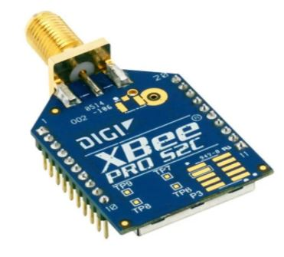
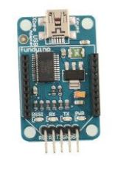
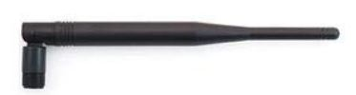
GCS Overview
Send calibration command
Start telemetry command
Science Payload Data
Receive telemetry data
Carrier XBee
Payload XBee
Receive telemetry data
.csv files and graph
GCS Antenna
GCS XBee
XBee USB Adapter
GCS GUI
GCS GUI
Presenter: Name goes here

Slide 50
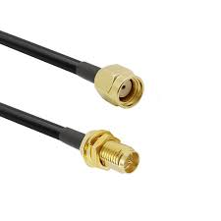
GCS Design
Data from Carrier XBee
RP SMA
Male to Female
connector
GCS Antenna
GCS XBee
XBee USB Adapter
GCS GUI
The laptop can operate for at least 5 hours
A backup laptop will be present with GUI installed in it
The laptop will be kept under shade and a cooling fan will be used
Updates for OS, if any, will be done the beforehand and the auto update feature will be disabled
The laptop will be disconnected from internet on the day of launch
Presenter: Name goes here

Slide 51
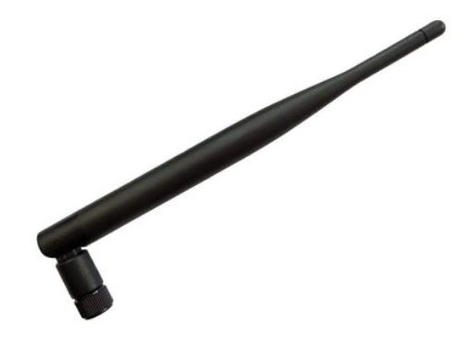
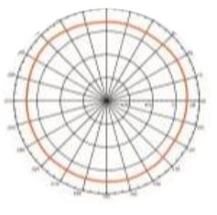
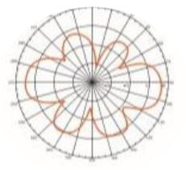
GCS Antenna Trade & Selection
Antenna | Gain (dBi) | Connector | VSWR | Frequency (GHz) | Polarization | Cost
Omni SMA Male Antenna | 5 | SMA | <2.0 | 2.4-2.5 | Vertical | 2.59
Magnetic Mount Antenna | 3 | SMA-Male | <2.0 | 2.4-2.483 | Linear | 2.04
Selected : Omni SMA Male Antenna
Radiation Pattern
Rationale: Better gain
Presenter: Name goes here

